Slide 1
Why chosen specific use case
E-commerce companies like AMazon , flipkart uses different recommendation systems to provide suggestions to the customers.Amazon uses currently item-item collaberrative filtering, which scales to massive datasets and produces high quality recommendation system in the real time. This system is a kind of a information filtering system which seeks to predict the "rating" or preferences which user is interested in.

Slide 2
Introduction to Recommendation systems
In this modern world we are overloaded with data and this data provides us the useful information. But it's not possible for the user to extract the information which interest them from these data. In order to help the user to find out information about the product , recommedation systems where developed. Recommeder system creates a similarity between the user and items and exploits the similarity between user/item to make recommendations. What recommeder system can solve ? It can help the user to find the right product. It can increase the user engagement. For example, there's 40% more click on the google news due to recommendation. It helps the item providers to deliver the items to the right user.In Amazon , 35 % products get sold due to recommendation. It helps to make the contents more personalized.In Netflix most of the rented movies are from recommendations.

Slide 3
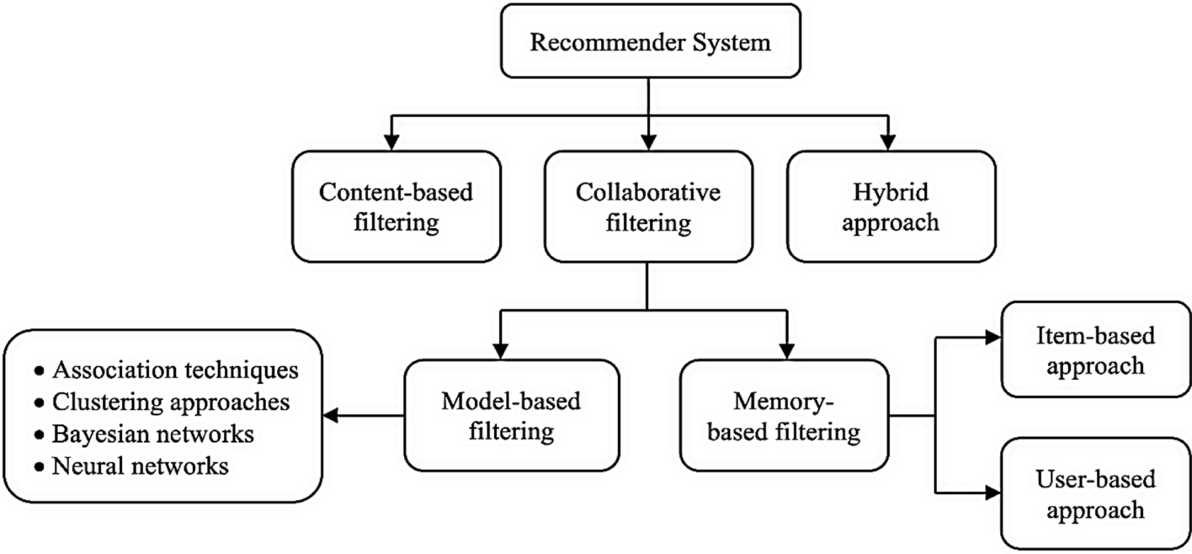
Types of recommendations

Slide 4
Summary of research done
https://journalofbigdata.springeropen.com/articles/10.1186/s40537-022-00592-5
https://www.globalscientificjournal.com/researchpaper/Research_Paper_On_Recommendation_System.pdf
https://jmcauley.ucsd.edu/data/amazon/

Slide 5
Algorithm Flow
Data Preparation: The input data is assumed to be in the form of a Pandas DataFrame (new_df) containing columns for userId, productId, and Rating.
Reader and Dataset: A Reader object is defined with the rating scale (in this case, ratings range from 1 to 5). The Surprise library's Dataset is used to load the data from the DataFrame.
Train-Test Split: The dataset is split into training and testing sets using the train_test_split function from Surprise.
Collaborative Filtering Algorithm: The collaborative filtering algorithm chosen is KNNBasic from Surprise. Similarity options are set, specifying that cosine similarity is used, and the collaborative filtering is user-based.
Training the Model: The algorithm is trained on the training set using the fit method.
Making Predictions: Predictions are made on the test set using the trained model.
Evaluation: The root mean squared error (RMSE) is calculated as a measure of the model's performance on the test set.
Top N Recommendations: A function (get_top_n_recommendations) is defined to extract the top N recommendations for each user from the test predictions.
User-Specific Recommendations: For a specific user (identified by 'user_id'), the top 5 recommendations are obtained and displayed.

Slide 6
Model Validation
Model-based collaborative filtering system¶ These methods are based on machine learning and data mining techniques. The goal is to train models to be able to make predictions. For example, we could use existing user-item interactions to train a model to predict the top-5 items that a user might like the most. One advantage of these methods is that they are able to recommend a larger number of items to a larger number of users, compared to other methods like memory based approach. They have large coverage, even when working with large sparse matrices.

Slide 7
Final Outcome
This is the list of product ID for recommendation
['1400501776',
'1400698987',
'6301977173',
'7214047977',
'9573212919',
'9625993428',
'9983891212',
'B000001ON6',
'B00000IGBF',
'B00000J08Q',
'B00000J0D2',
'B00000J1TX',
'B00000J1UQ',
'B00000J1V3',
'B00000J3UJ',
'B00000J434',
'B00000J4FS',
'B00000J4GE',
'B00000JCT8',
'B00000JCTO',
'B00000JFIF',
'B00000JPPI']

Slide 8
Prediction based on item item recommendation
[Prediction(uid='A3RVCNRATAAOLW', iid='B00001P4ZH', r_ui=5.0, est=4.062176165803109, details={'was_impossible': True, 'reason': 'User and/or item is unknown.'}), Prediction(uid='A2QQ2GS40R57BU', iid='1400698987', r_ui=5.0, est=4.062176165803109, details={'was_impossible': True, 'reason': 'User and/or item is unknown.'}), Prediction(uid='A156G7A9XOYFYA', iid='B00001P4ZH', r_ui=5.0, est=4.062176165803109, details={'was_impossible': True, 'reason': 'User and/or item is unknown.'}), Prediction(uid='A38UNL04ZTDTGB', iid='B00000JI4F', r_ui=4.0, est=4.062176165803109, details={'was_impossible': True, 'reason': 'User and/or item is unknown.'}), Prediction(uid='ACMKJIW7FKAR5', iid='1400501776', r_ui=5.0, est=4.062176165803109, details={'was_impossible': True, 'reason': 'User and/or item is unknown.'}), Prediction(uid='ATJH6BHT1B4L6', iid='B00000J3Q7', r_ui=1.0, est=4.062176165803109, details={'was_impossible': True, 'reason': 'User and/or item is unknown.'}), Prediction(uid='A3VJ40823I3R15', iid='B00001P4ZH', r_ui=4.0, est=4.062176165803109, details={'was_impossible': True, 'reason': 'User and/or item is unknown.'}), Prediction(uid='A7R4R9THNELTP', iid='0972683275', r_ui=5.0, est=4.062176165803109, details={'was_impossible': True, 'reason': 'User and/or item is unknown.'}), Prediction(uid='A164IWQTXAR8C1', iid='B00001P4ZH', r_ui=4.0, est=4.062176165803109, details={'was_impossible': True, 'reason': 'User and/or item is unknown.'}), Prediction(uid='A31K78RDPK1UKE', iid='B00001P4ZH', r_ui=4.0, est=4.062176165803109, details={'was_impossible': True, 'reason': 'User and/or item is unknown.'}), Prediction(uid='A23XH0IU02M6AF', iid='B00001P4XA', r_ui=2.0, est=4.062176165803109, details={'was_impossible': True, 'reason': 'User and/or item is unknown.'}), Prediction(uid='A2J4VHYFK340OC', iid='B00000JBAT', r_ui=4.0, est=4.062176165803109, details={'was_impossible': True, 'reason': 'User and/or item is unknown.'}), Prediction(uid='APB1VAE7P1CAV', iid='B000001ON6', r_ui=3.0, est=4.062176165803109, details={'was_impossible': True, 'reason': 'User and/or item is unknown.'}), Prediction(uid='A28PS2UIM47TJJ', iid='B00001W0DD', r_ui=4.0, est=4.062176165803109, details={'was_impossible': True, 'reason': 'User and/or item is unknown.'})

Slide 9
Potential benefits
Enhanced User Experience:
Personalized recommendations lead to a more satisfying user experience.
Saves time by efficiently guiding users to relevant content or products.
Increased User Engagement:
Tailored suggestions boost user engagement and retention.
Users are more likely to spend time on platforms that understand their preferences.
Improved Customer Satisfaction:
E-commerce platforms can increase customer satisfaction by suggesting products aligned with user preferences.
Higher Conversion Rates:
Recommendations lead to higher conversion rates by guiding users toward relevant products or services.
Optimized Content Discovery:
Users discover new and relevant content, expanding their interests.
Increased Revenue:
E-commerce platforms experience higher revenue through upselling and cross-selling facilitated by recommendations.
Reduced Information Overload:
Recommendations help users navigate information overload by presenting a manageable subset based on preferences.
Enhanced Marketing and Advertising:
Marketers can target users with personalized advertisements, increasing the likelihood of conversions.
Discovery of Long-Tail Items:
Users are exposed to niche or long-tail items, benefiting both users and businesses.
Data-Driven Decision Making:
Organizations leverage recommendation system data for analytics and strategic decision-making.
Competitive Advantage:
Businesses with effective recommendation systems gain a competitive edge by providing a superior and personalized user experience.

Slide 10
GitHub Repository
https://github.com/TusharDh2001/OneLogicaProject/

